Slide 1





NextGen In A Box (NGIAB): Advancing Collaborative Modeling for Enhanced Water Resource Management
CIROH@UA : Arpita Patel, James Halgren, Benjamin Lee, Sepehr Karimi, Trupesh Patel, Josh Cunningham, Shahab Alam, Steve Burian, Purushotham Bangalore, Jeff Carver
Lynker: Nels Frazier, Zach Wills, Jordan Laser, Mike Johnson, Josh Sturtevant
Date: 13th Dec, 2023

Slide 2


NextGen Framework
The NextGen Water Resources Modeling Framework (NextGen) is developed by NOAA OWP at the National Water Center
Enhance the forecasting of flooding and drought
Improve water resource management
Protect lives, property, and the environment
Multimodel computational framework for NWM (National Water Model)
NextGen GitHub Repository: GitHub: NOAA-OWP/ngen
NextGen Wiki: GitHub: NOAA-OWP/ngen/wiki
Notes:
• NextGen In A Box Ready-to-run, containerized and cloud-friendly version of NextGen framework, packaged with scripts to help prepare data and get you modeling more quickly

Slide 3
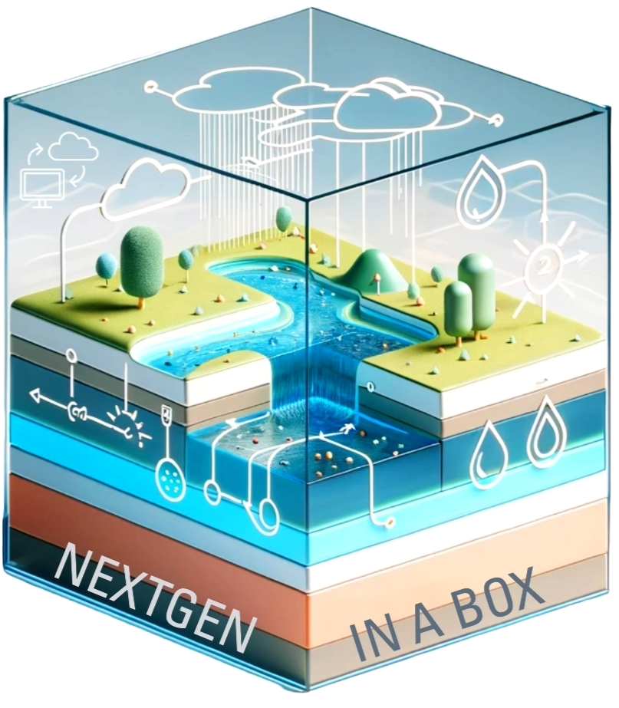
NextGen In A Box (NGIAB)
NextGen In A Box Ready-to-run, containerized and cloud-friendly version of NextGen framework, packaged with scripts to help prepare data and get you modeling more quickly.
Containerized Solution
Cloud Friendly Nature
Simplifies NextGen Access
Collaborative Modeling Tool
Run anywhere
Pre-compiled images available in Docker Hub
Reduce the research time
Easily configure multiple models
Multi-cloud compatible
Reduce learning curve for NextGen framework
Compare model performance
Facilitates accessibility and accelerates modeling
Easy to use
Reproducible research outcomes
Increase collaboration among researchers

Slide 4

Open-Source Research Practices
NGIAB GitHub Repository: https://github.com/CIROH-UA/NGIAB-CloudInfra
Leveraging Open-Source Technologies
Git version control
GitHub
Continuous Integration & Continuous Deployment (CI/CD)
GitHub Actions
Docker
Singularity
Fostering Transparency and Reproducibility in Research

Slide 5
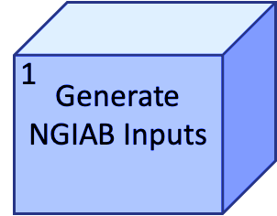
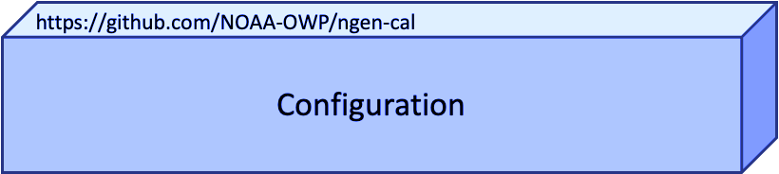


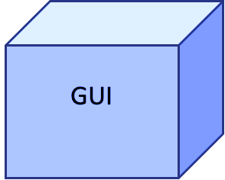
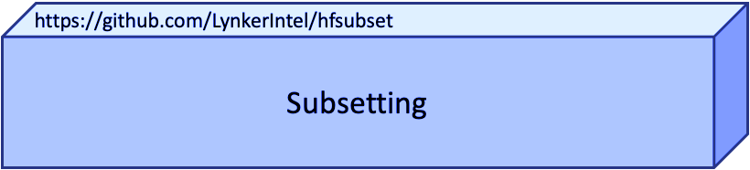

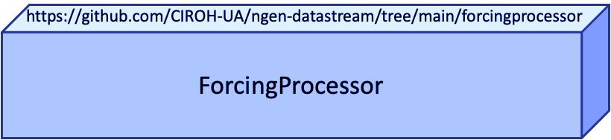
How to Generate NGIAB Inputs?
ngen-run/
├── config/
├── forcings/
├── metadata/
└── outputs/

Slide 6
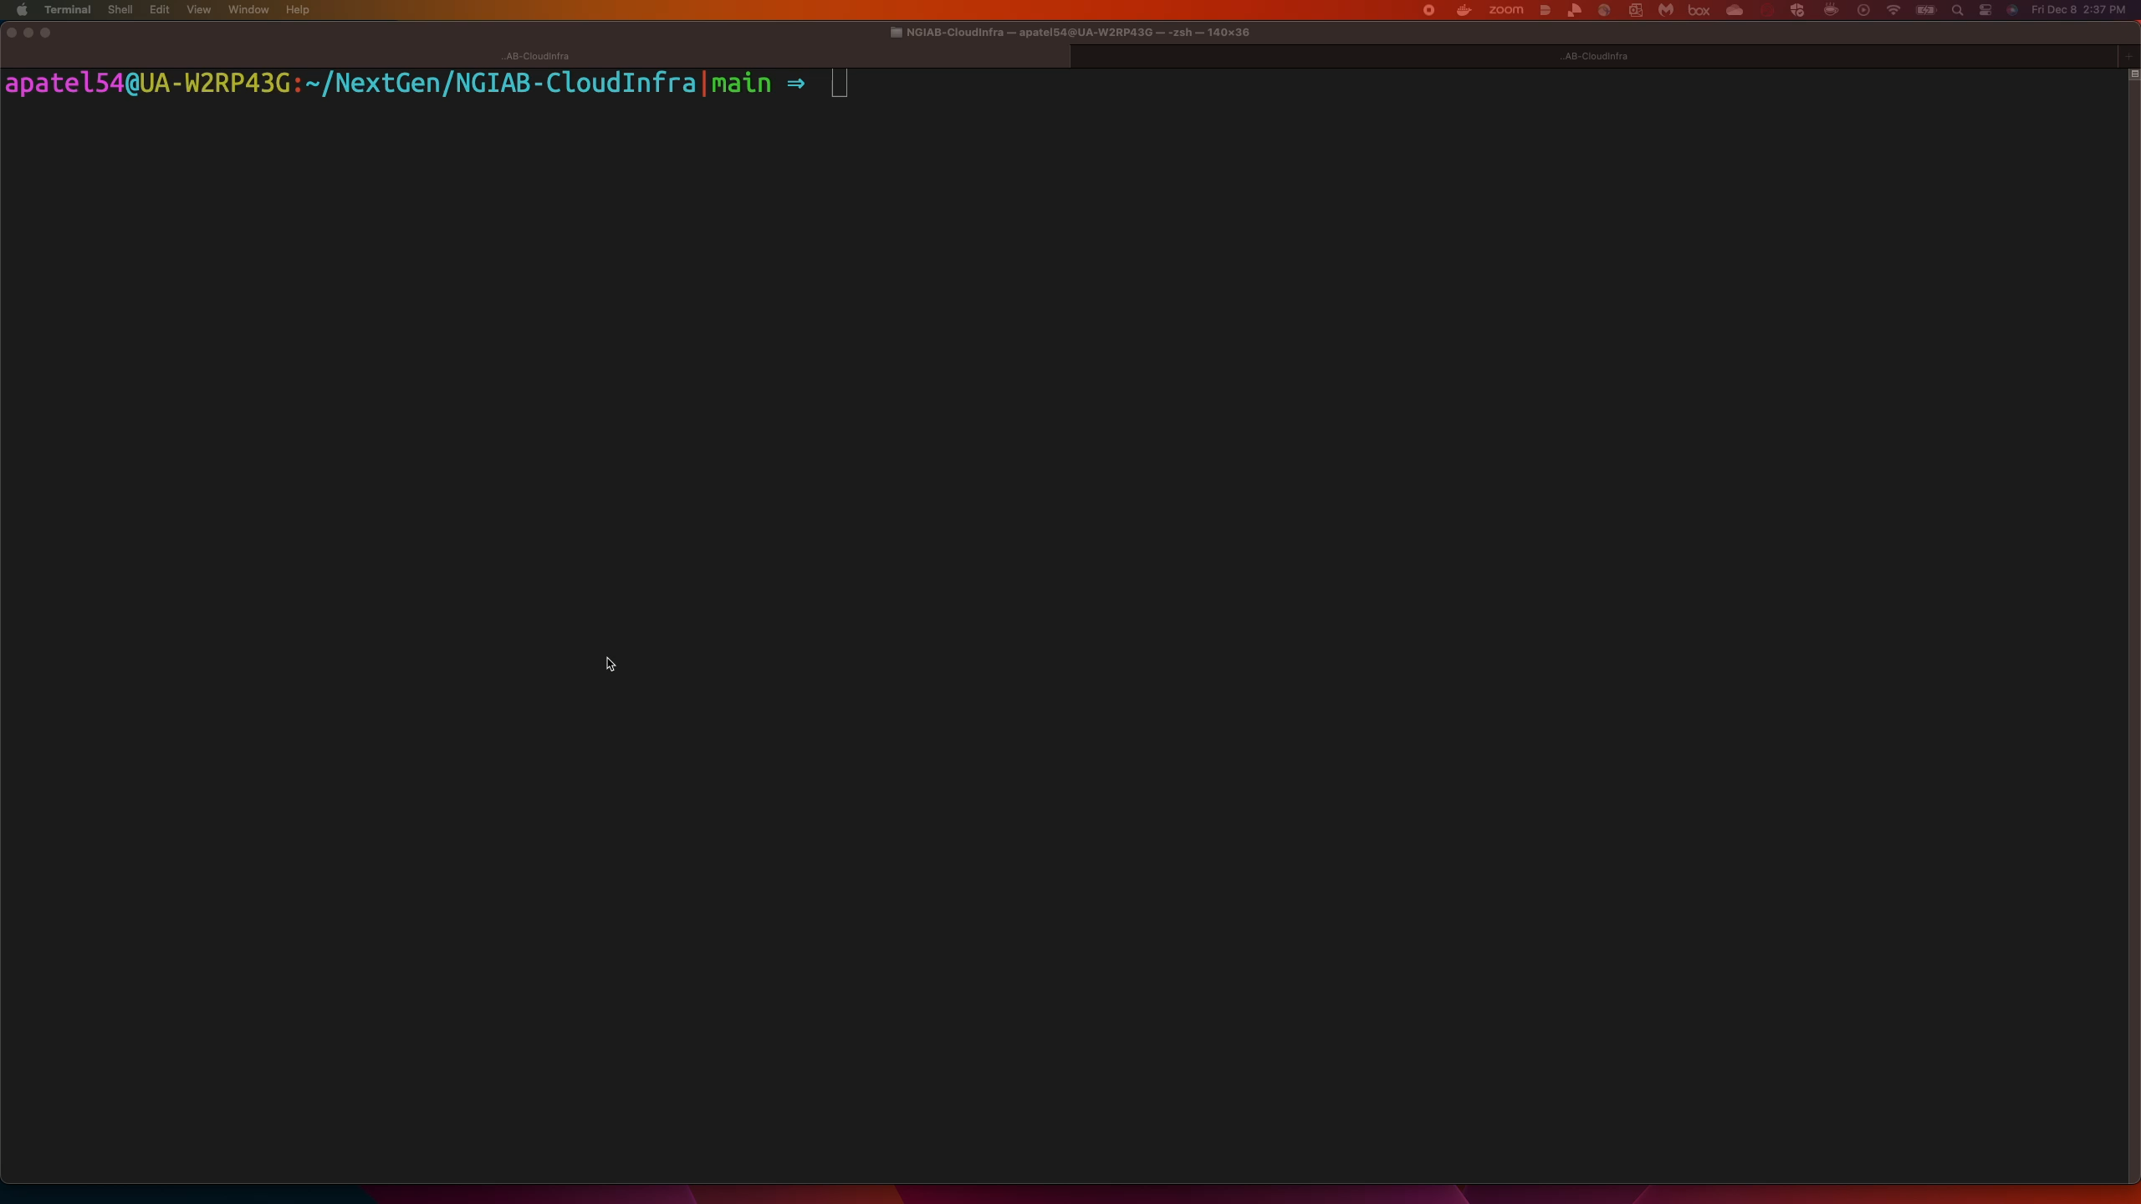
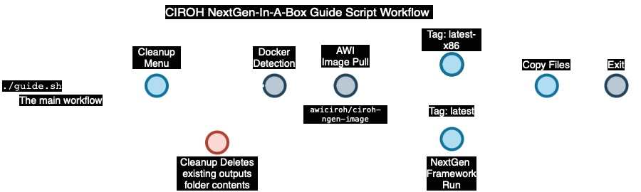
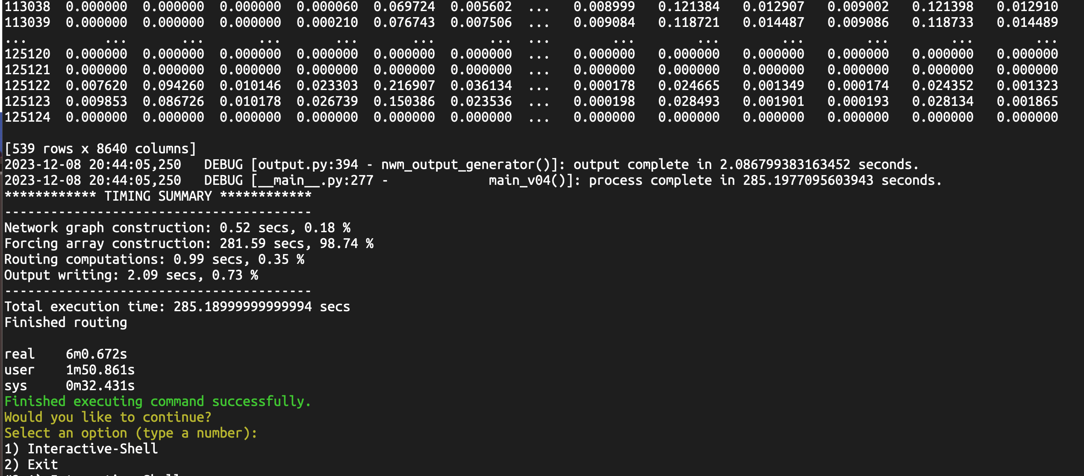
How to Run NGIAB?

Slide 7
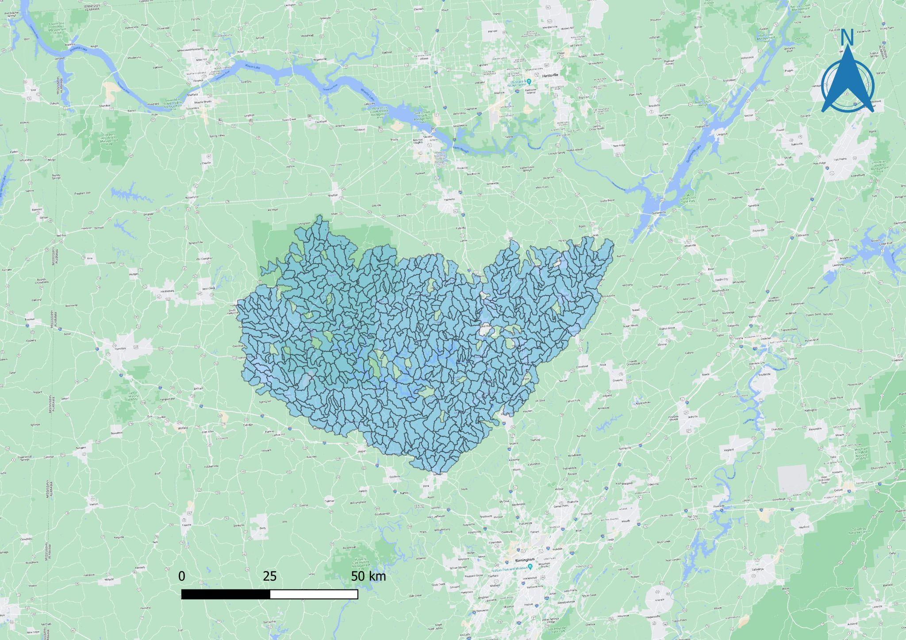
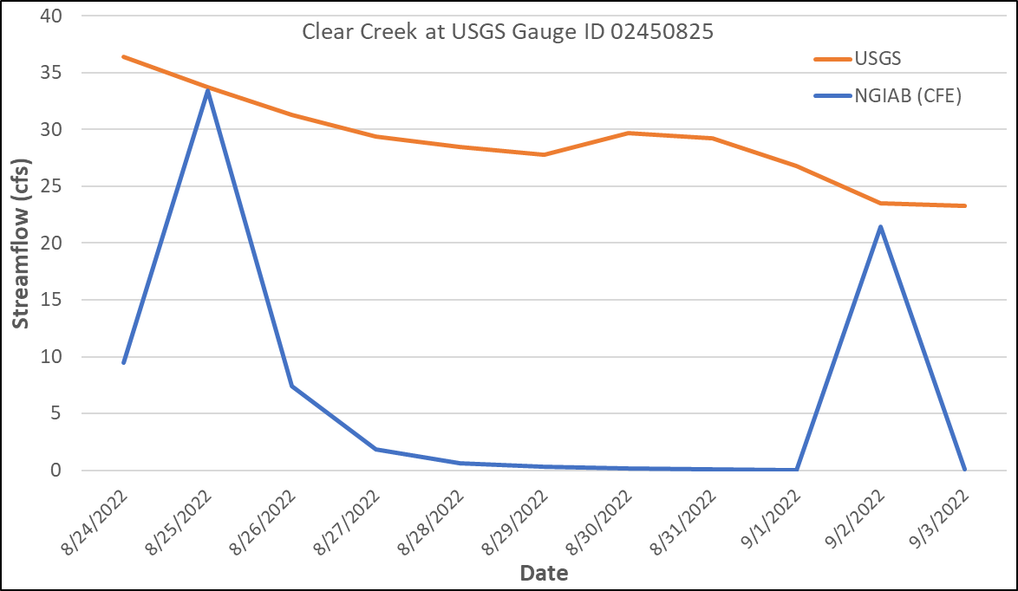
Example Case 1
Sloth + CFE + Troute using NextGen for streamflow modeling for Sipsey Fork, Black Warrior River near Clear Creek, AL (03W VPU)
10 days of simulation for 500+ catchments.
Results can be replicated by anyone.
Data package : https://ciroh-ua-ngen-data.s3.us-east-2.amazonaws.com/AWI-002/AWI_03W_113060_002.tar.gz
Input Map for Sipsey Fork, Black Warrior River, AL
Output plot showing Streamflow for
Clear Creek at USGS Gauge ID

Slide 8
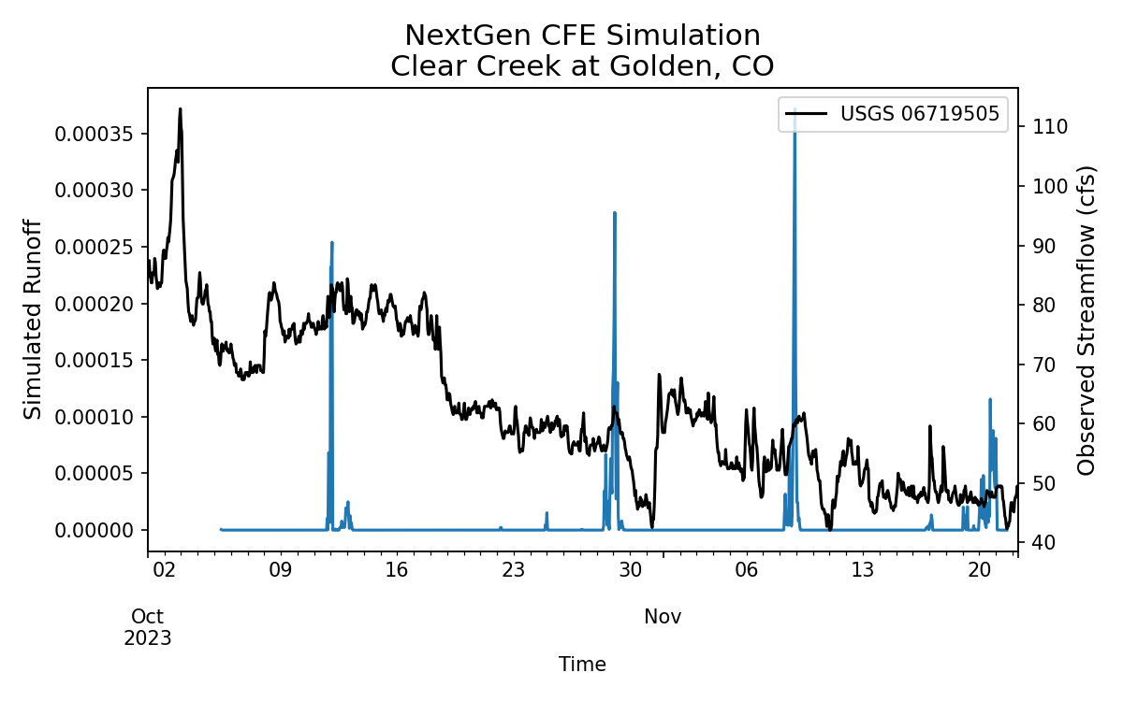
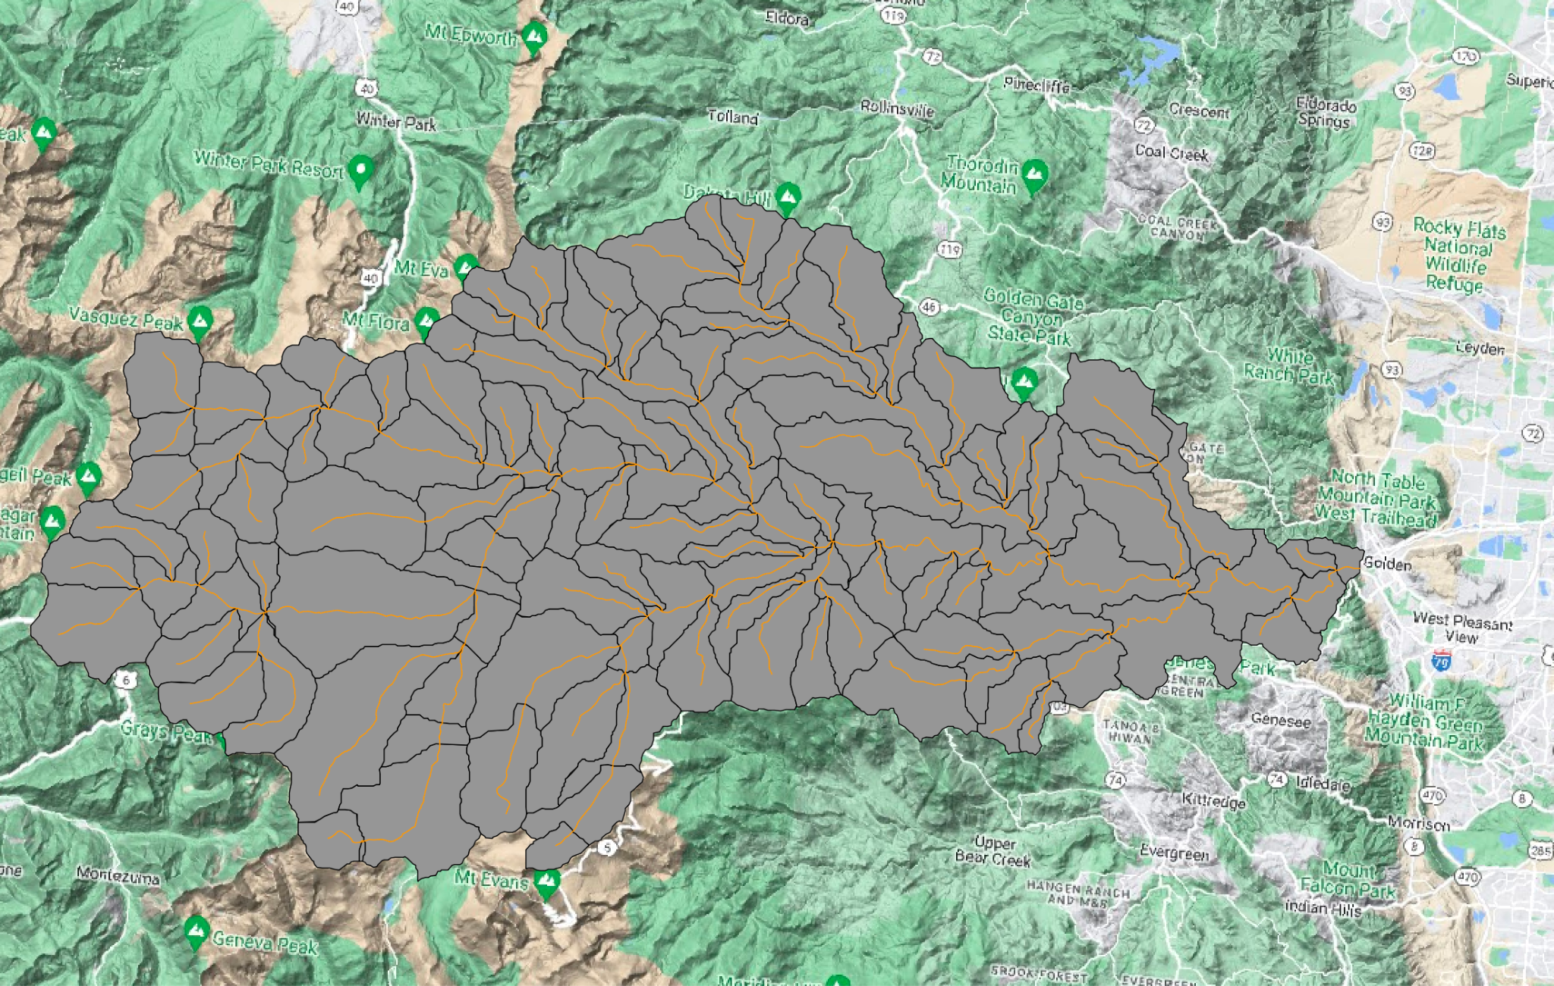
Example Case 2
Simulation using CFE within NextGen for streamflow modeling for Clear Creek at Golden, CO
Data package : coming soon
Input Map for Golden, CO
Output plot showing Simulated Runoff for Clear Creek at Golden, CO

Slide 9
NGIAB Releases
Release : 16th May 2023
CFE, NOAA-MP, Python support
v0.0.1
v1.0.0
v1.1.0
NGIAB - Feb 3, 2023
Initial Version
Release : 28th Nov 2023
CFE + SLOTH + t-route Models supported - for serial and parallel mode.

Slide 10
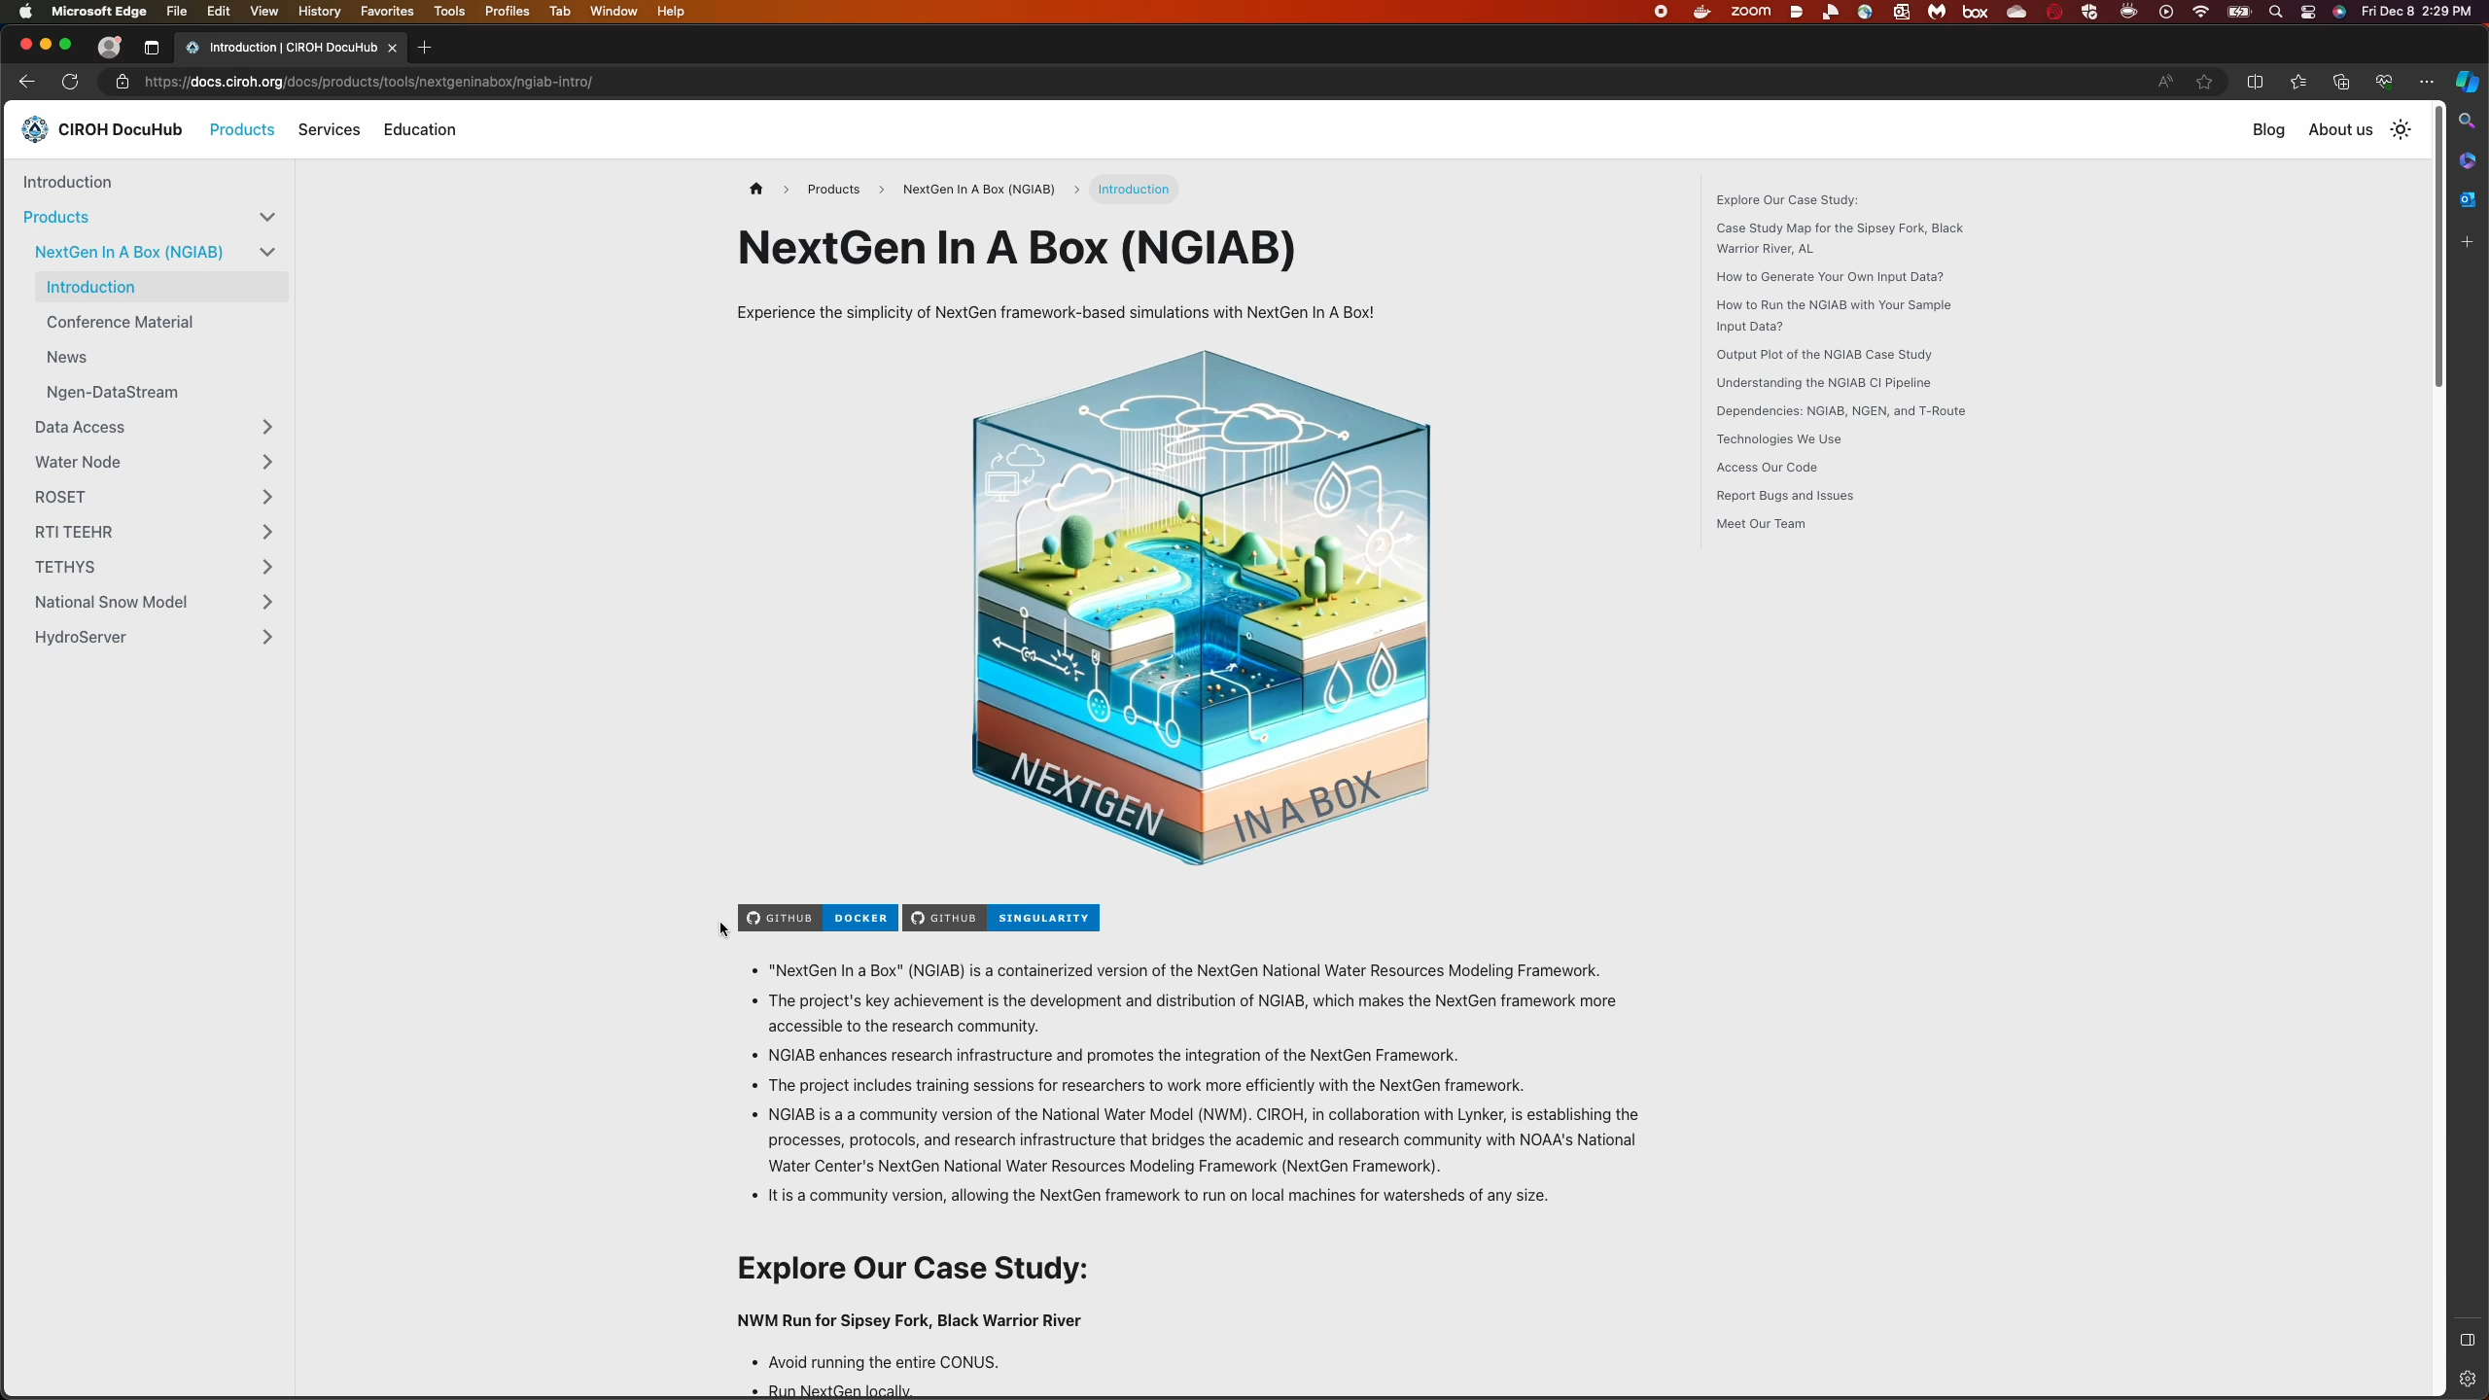

CIROH DocuHub
DocuHub: docs.ciroh.org
Community editable technical documentation hub!
Documentation, Services, and news at CIROH DocuHub!
Find information about NGIAB and data stream here: https://docs.ciroh.org/docs/products/tools/nextgeninabox

Slide 11
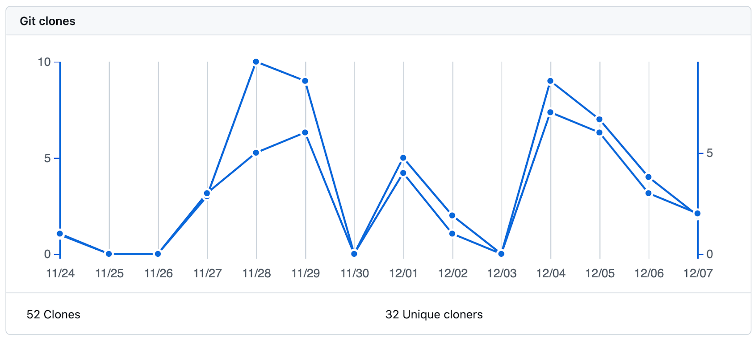
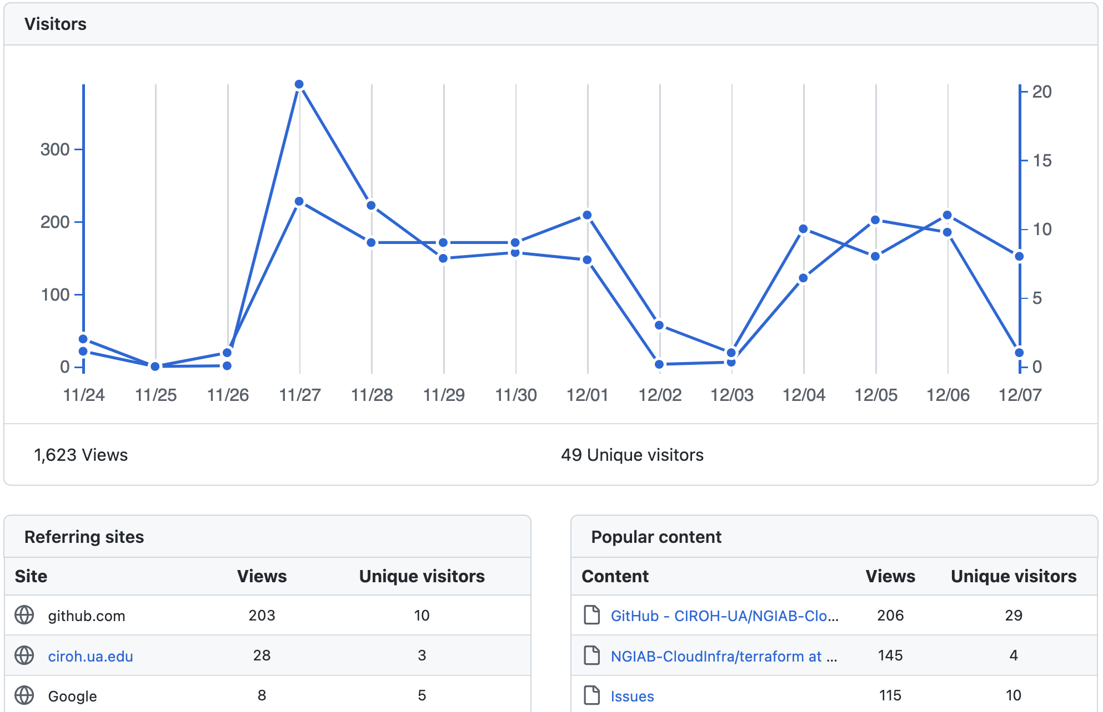
Insights
NGIAB GitHub Repository
# of views
Unique clones
Forks
Popular content

Slide 12
Future Development

Slide 13
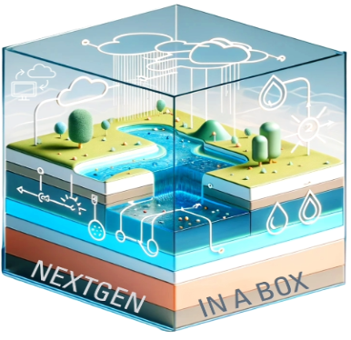
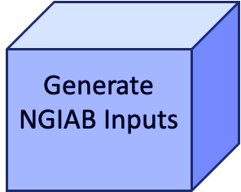
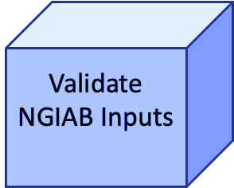
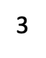
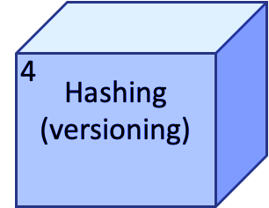
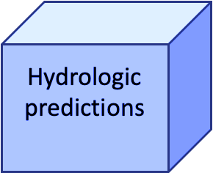
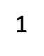
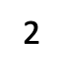
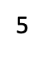
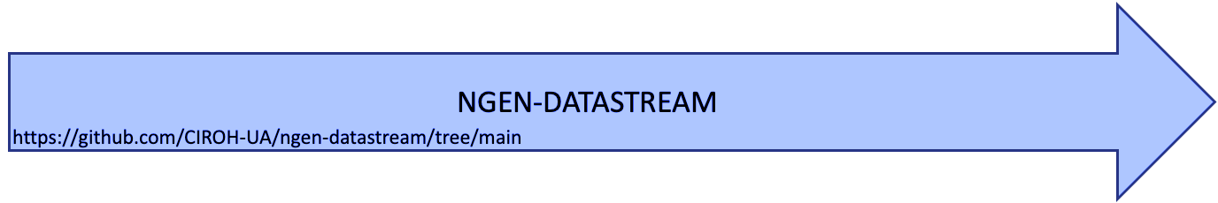
NextGen Data Stream Conceptual Model
We are working on to build out an "over-the-loop" (i.e. automated) real-time streamflow forecasting system
Notes:
ngen-datastream refers to the software chain that builds valid ngen-run input packages, executes NEXTGEN with NGIAB, and versions the entire run. NEXTGEN is a framework that coordinates hydrologic model configuration, parameterization, and execution across spatial domains. NGIAB consists of the NEXTGEN docker container pre-built for the user’s architecture as well as software that aids users in properly running the container.

Slide 14
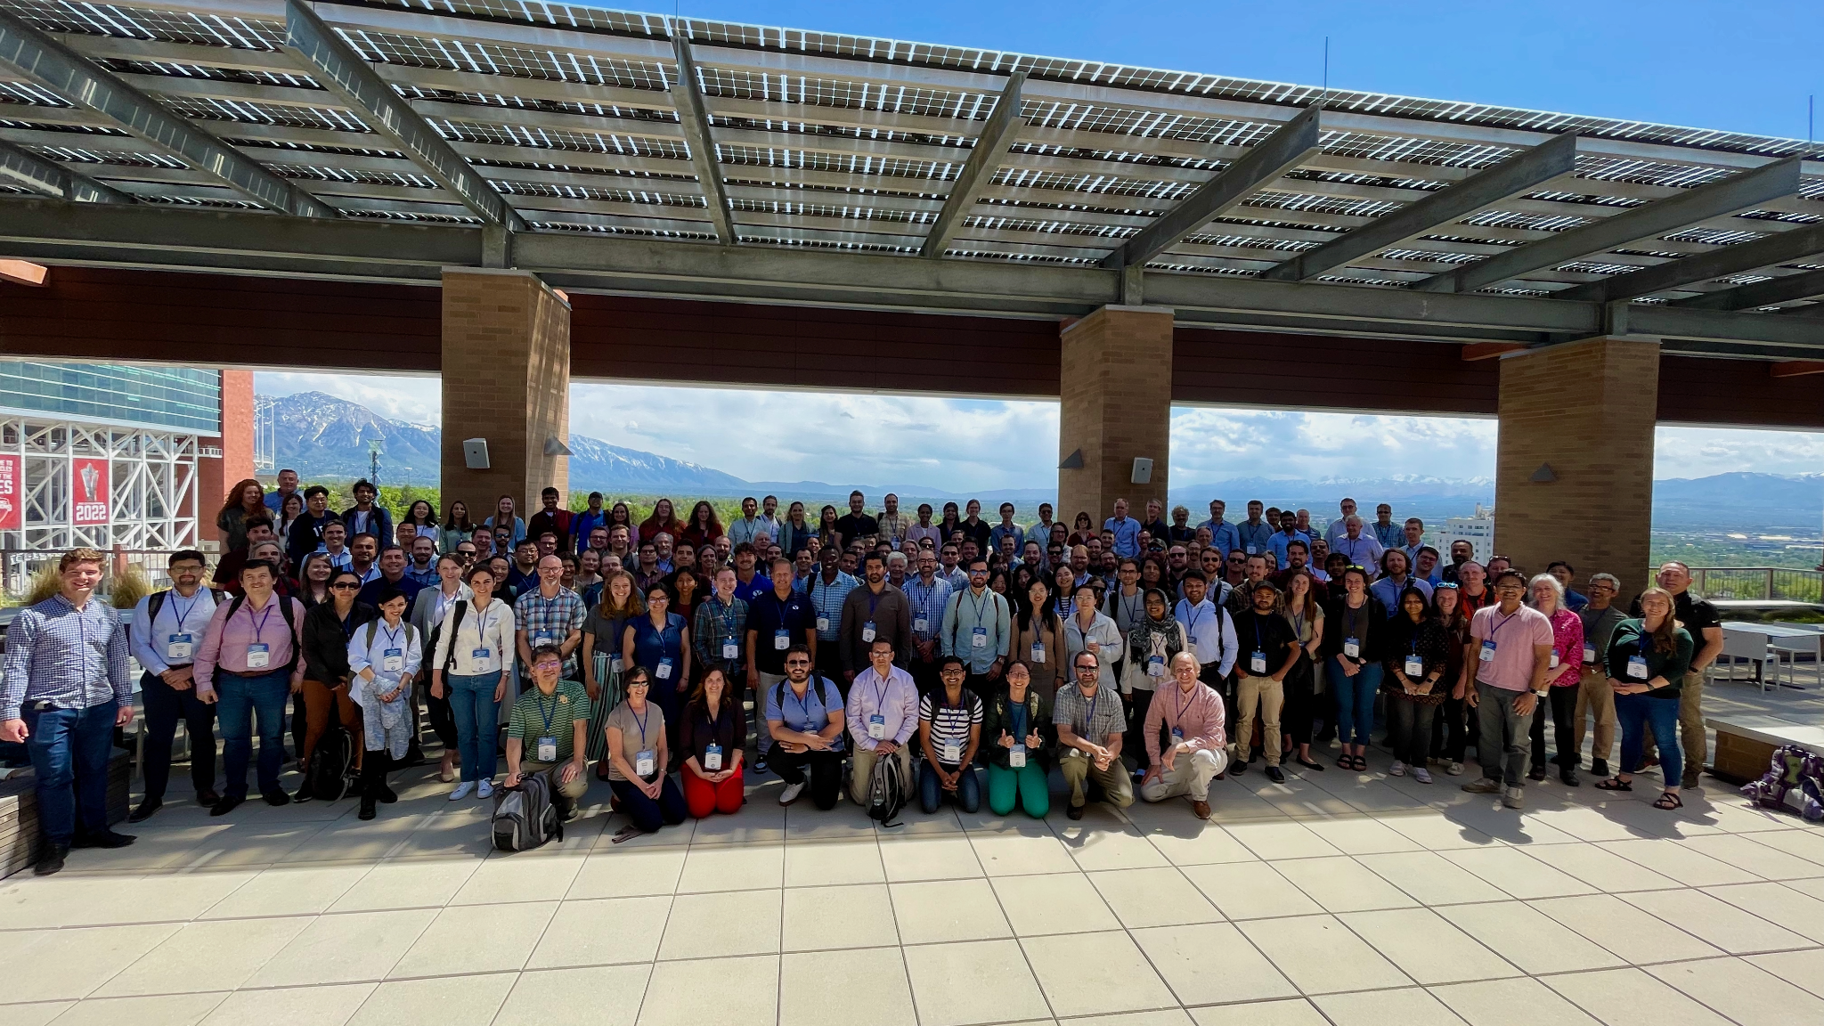

Community Impact
Call for Community Engagement!
Community plays big role in contributing to the enhancement of NGIAB.
Community Development Version
Facilitates easy adoption for researchers of all technical background.
Supports diverse research and development projects.
Driven by active collaboration and contribution from the community.
CIROH DevCon1 - May 2023 (Salt Lake, UT)
Contribute: https://github.com/CIROH-UA/NGIAB-CloudInfra/issues

Slide 15
Useful links and ongoing development
NGIAB (using docker) - https://github.com/CIROH-UA/NGIAB-CloudInfra
NGIAB (using singularity) - https://github.com/CIROH-UA/Ngen-Singularity
CIROH DocuHub - docs.ciroh.org , https://github.com/CIROH-UA/ciroh-ua_website
NGIAB Docs - https://docs.ciroh.org/docs/category/nextgen-in-a-box-ngiab
DataStream - https://github.com/CIROH-UA/ngen-datastream
ForcingProcessor - https://github.com/CIROH-UA/ngen-datastream/tree/main/forcingprocessor
Realization generation and ngen run folder validation - https://github.com/NOAA-OWP/ngen-cal
Hydrofabric subsetting - https://github.com/LynkerIntel/hfsubset
Hashing/Versioning - https://github.com/aaraney/ht
Ngen Wiki - https://github.com/NOAA-OWP/ngen/wiki
HyAggregate - https://mikejohnson51.github.io/hyAggregate/
CIROH - ciroh.ua.edu

Slide 16
Key Terminology
NGIAB - NextGen In A Box (Next Generation National Water Model)
NGEN - Next Generation National Water Model
Catchment - geographic area characterized by a single location, a nexus, where all precipitation in the area runs off through. A drainage basin.
Nexus - the singular point where water flows into or out of a catchment. Often a point along a river.
Subsetting - to reduce a large geopackage (many catchments) down to a smaller geopackage (fewer catchments) . In effect, this is choosing the domain over which ngen will run.
Hashing - SHA256 algorithm applied to files to generate a unique id for a file. Useful for preserving and distinguishing unique inputs.
Validation - Ensuring the ngen input directory data_dir has been constructed properly. Properly meaning that NextGen will not crash and will generate output data.

Slide 17
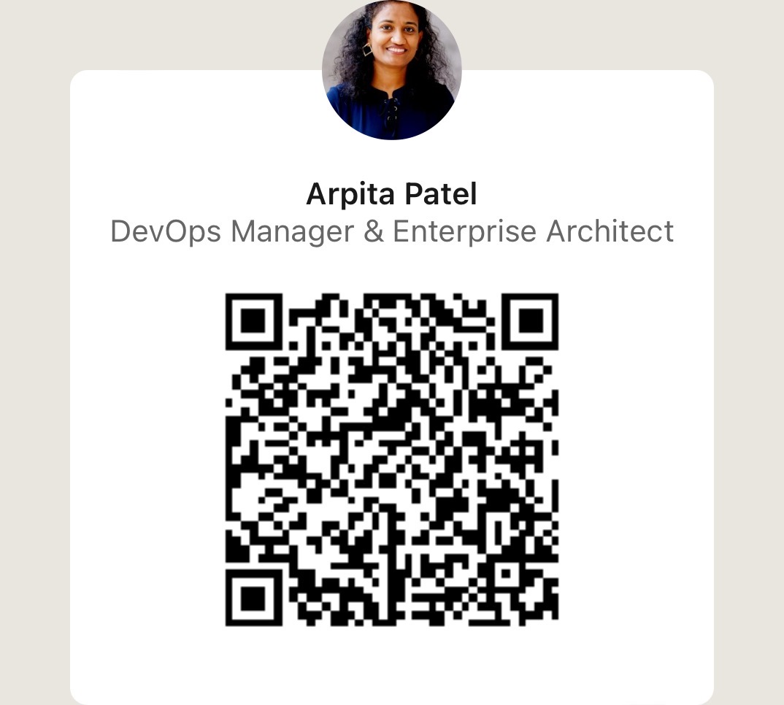
Q&A
NGIAB Support Team
Join us on CIROH Slack
Channel CIROH Slack: #nextgen_help_2023
Email : ciroh-it-admin@ua.edu
Arpita Patel
apatel54@ua.edu
Thank You!

